Slide 1
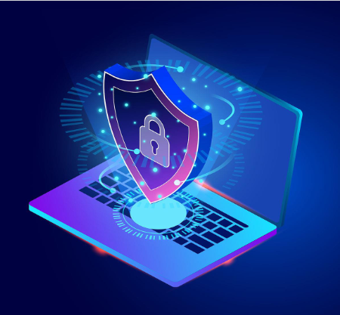
Live Cyber FORENSICS
Group ID: BCA2301
Priya Godse – 2020-B-03102002
Suyog Deshmukh – 2020-B-22122000A
Guided By: Ayushi Godiya

Slide 2
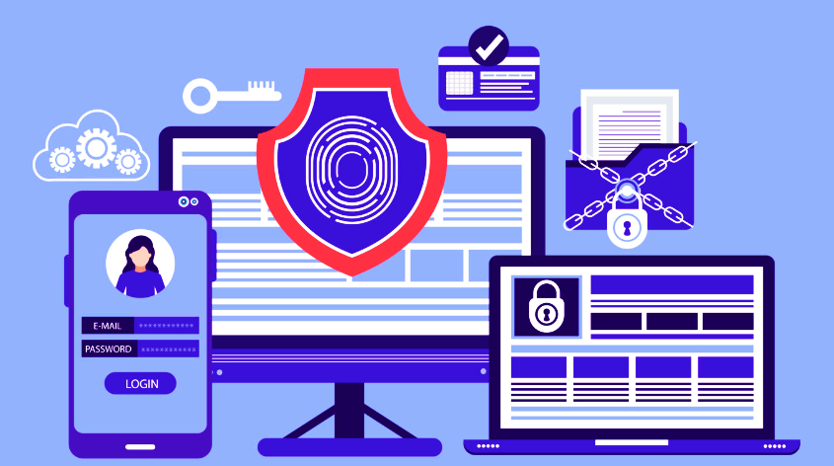
Contents
Introduction
Literature Review
Research Gaps
Objectives
Methodology
Architecture
Results and Discussion
Conclusion
Future Scope
References

Slide 3
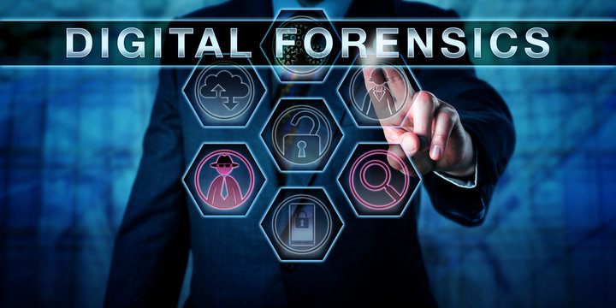
Introduction
Live digital forensics, also known as live analysis or live response, is the process of collecting and analyzing digital evidence from an actively running or recently shut down system. This approach differs from traditional digital forensics and is becoming increasingly important due to the evolution of technology and the sophistication of cyber attacks. digital forensics involves various techniques and tools to capture and analyze digital evidence in real-time. It is used in various contexts, including incident response, regulatory compliance, internal investigations, and e-discovery. However, it presents unique challenges that require skilled forensic analysts with deep technical and legal knowledge to effectively carry out investigations.

Slide 4
Literature Review
Live digital forensics is an essential aspect of digital forensics that has been extensively discussed in the literature. The literature emphasizes the significance of live digital forensics in responding to cyber incidents and its potential applications in contexts such as regulatory compliance, internal investigations, and e-discovery. The studies highlight the unique challenges that live digital forensics presents, including minimizing disruption to the system, preventing potential loss or modification of evidence, and analysing data in real-time. Technical studies have identified various tools and techniques, such as Data Recovery , Data analysis, and Cloning/imaging that are commonly used in digital forensics investigations. Legal and regulatory studies emphasize the importance of maintaining evidence integrity during analysis, having clear policies and procedures, and effective communication and coordination among various stakeholders involved in the investigation. Skilled forensic analysts must have a deep understanding of both the technical and legal aspects of digital forensics to effectively carry out live digital forensics investigations.

Slide 5
Research Gaps
Although digital forensics has been extensively studied, there are several research gaps that remain to be addressed. One significant research gap is the need for more comprehensive frameworks for digital forensics investigations that can guide forensic analysts through the process. Another research gap is the need for standardized tools and techniques for live digital forensics investigations to improve their reliability and effectiveness. In addition, there is a need for more research on the ethical considerations of live digital forensics investigations, including the impact on individuals' privacy and the potential for unintended consequences. There is also a need for more research on the impact of emerging technologies, such as artificial intelligence and machine learning, on digital forensics investigations. Finally, there is a need for more research on the training and education of forensic analysts in digital forensics, including the development of specialized curricula and training programs to build the necessary skills and expertise.

Slide 6



Objectives
Cloning :- To create an exact, bit-for-bit copy of a hard drive, partition, or file system for backup, analysis, or data recovery purposes, without altering the original data or compromising its integrity.
Data Recovery :- Recover lost, damaged or corrupted data from storage devices to restore access and functionality, while minimizing further data loss and maintaining data integrity It allows forensic investigators to recover deleted data and analyse the event as it occurs.
Mobile Forensics :- Mobile forensics is to retrieve and analyse digital data from mobile devices for investigative and legal purposes, including recovery of deleted data, identifying user activities, and providing evidence in criminal investigations
Preserving evidence :- The collection and preservation of digital evidence are crucial in legal proceedings, and live digital forensics plays a vital role in ensuring the integrity of the evidence collected.
Providing insight into an incident :- Live digital forensics can provide valuable insights into the nature of a cyber incident, including the tools and techniques used by attackers, the scope of the attack, and the data compromised. These insights can help organizations prevent similar attacks in the future.

Slide 7
Methodology
The technique of live digital criminology includes the assortment, protection, and investigation of computerized proof from a running or as of late closed down framework. The interaction is basic for digital examinations, as it permits measurable investigators to accumulate proof without compromising the uprightness of the framework. Coming up next are the key advances associated with the procedure of live digital criminology:-
Preparation: The most important phase in live digital legal sciences is arrangement. This includes assembling every single important device and gear expected for the examination, including equipment and programming apparatuses for information procurement and investigation. Scientific investigators should likewise get appropriate lawful authority prior to directing any live examination.
Data Acquisition: The following stage is information securing, which includes gathering information from the running or as of late closed down framework. The information can be gathered utilizing different instruments and procedures, for example, circle imaging, network examination, and memory investigation.
Data Preservation: When the information is gained, guaranteeing its trustworthiness and tolerability in court should be saved. This includes making a criminological picture of the gained information, which is a little by little duplicate of the first information.
Data Analysis: The following stage is information investigation, which includes analyzing the criminological picture to separate significant data. The investigation can incorporate watchword look, course of events examination, and connection examination.
Reporting: The last step is detailing, which includes archiving the discoveries of the examination. The report should be clear, succinct, and permissible in court.
The methodology of live digital criminology requires progressed specialized abilities, legitimate information, and the utilization of specific devices and procedures. It likewise includes severe adherence to standard working methodology and rules to guarantee the respectability and acceptability of the advanced proof.

Slide 8
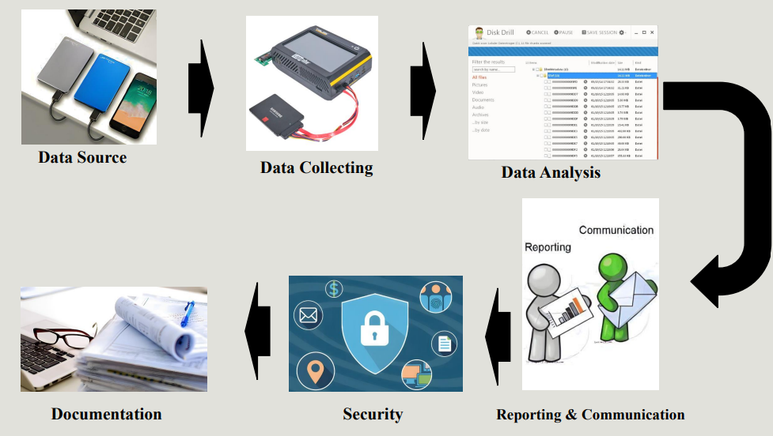
Architecture

Slide 9
Results and Discussion
Digital forensics is an emerging field that involves collecting and analysing digital evidence in real-time. This technique is essential for law enforcement agencies to collect evidence quickly, which can help to solve crimes quickly. The main advantage of digital forensics is that it allows investigators to recover data from HDD , which is deleted by mistake or intentionally. digital forensics also allows investigators to monitor activities. which helps to identify any malicious activity, and prevent further damage. However, there are some limitations to digital forensics. For example, the technique is reliant on a live system, which may not be possible if the system has already been shut down. Moreover, live digital forensics may be challenging to carry out if the system is infected with sophisticated malware. In conclusion, live digital forensics is a powerful tool that can help to collect and analyse digital evidence in real-time. However, its effectiveness depends on the situation and the level of sophistication of the digital attack. Law enforcement agencies should, therefore, consider this technique as a valuable tool in their forensic toolkit.

Slide 10
Conclusion
In conclusion, live digital forensics is a crucial area of study that focuses on acquiring and analyzing digital evidence in real-time. The practice has become increasingly relevant in recent years as our lives are becoming more reliant on digital devices and services. The development of live forensic tools and techniques has made it possible to collect, analyze and preserve volatile data in a way that does not interfere with the operations of a system or device. This ensures that investigations can be carried out while minimizing the impact on the system or device under investigation. However, it is important to note that the use of live forensic tools requires a high level of technical expertise and knowledge. Also, the evidence obtained through live digital forensics must adhere to legal and ethical guidelines. Overall, live digital forensics plays a vital role in maintaining the integrity of digital evidence and contributing to the success of digital investigations.

Slide 11
Future Scope
The future of digital forensics is moving towards real-time, live analysis of digital evidence. With the increasing amount of digital data, it is becoming more important to have tools and techniques to quickly analyze and extract information from devices, networks and systems. Live digital forensics will enable investigators to collect and analyze digital data as it is being created, giving them an instant understanding of what is happening on a network or system. The benefits of live digital forensics include faster response times, improved decision making, and more efficient investigations. The future of live digital forensics will also include advancements in artificial intelligence and machine learning, which will help to automate the process of analyzing large amounts of data. Overall, live digital forensics will play a vital role in the fight against cybercrime and will continue to evolve as technology advances.

Slide 12
References
1. Casey, E. (2011). Digital evidence and computer crime: Forensic science, computers and the internet. Academic Press.
2.Carrier, B. (2005). File system forensic analysis. Addison-Wesley.
3.Cohen, F. (2013). Advanced digital forensics: The future of digital forensics. Springer Science & Business Media.
4.Garfinkel, S., Farrell, P., Roussev, V., & Dinolt, G. (2009). Bringing science to digital forensics with standardized forensic corpora. Digital Investigation, 6, S2-S11.

Slide 13
THANKS

